Slide 1
PHP in depth 12
3870

Slide 2
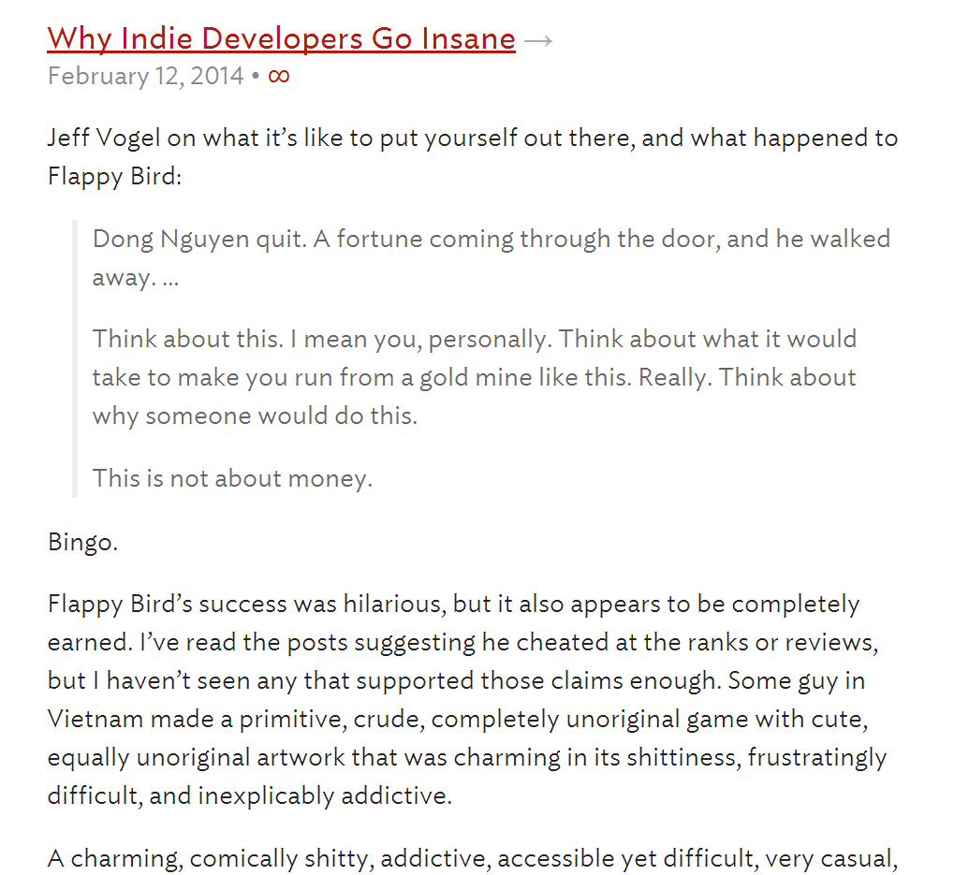
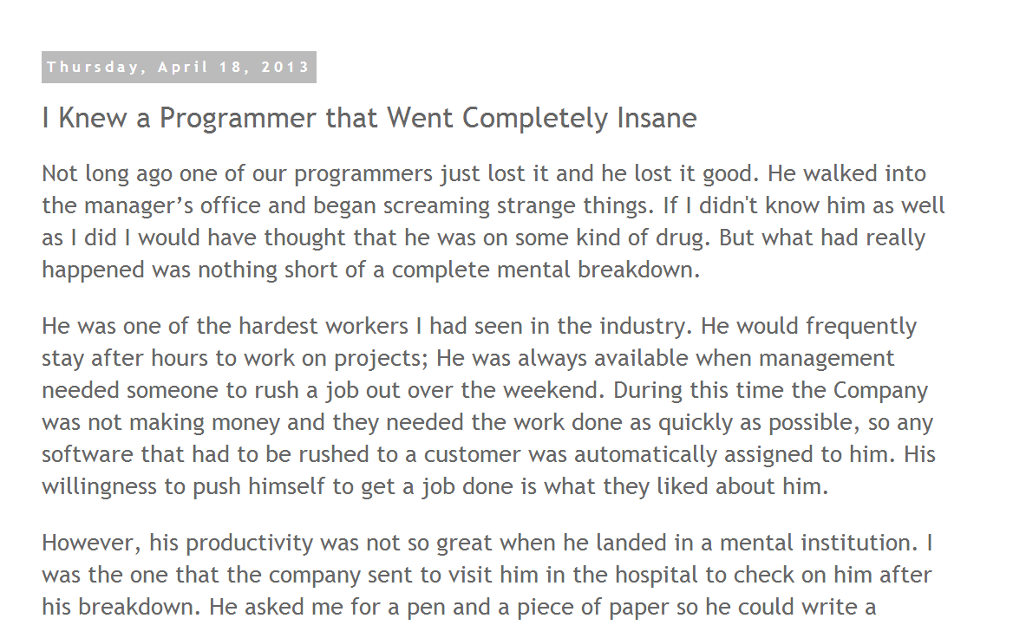
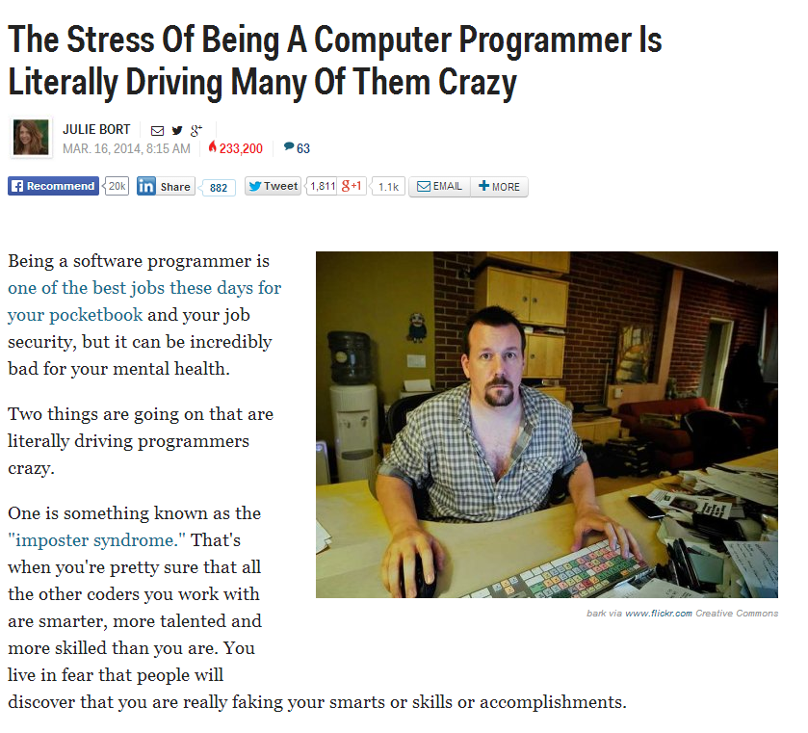

Slide 3
Let's vote
On Piazza:
What kind of developer do you want to be?
How do you find out what kind of developer you want to be?

Slide 4
Organization Types
Process driven
Vs.
Commitment driven
Safety Critical
Vs.
Creative Inventive

Slide 5
Motivators
Achievement
Possibility for growth (challenging work!)
Work itself
Personal life
Technical-supervision opportunity
Advancement

Slide 6
Demotivators
Hygiene Factors
Management manipulation
Excessive schedule pressures
Lack of appreciation
Low quality

Slide 7
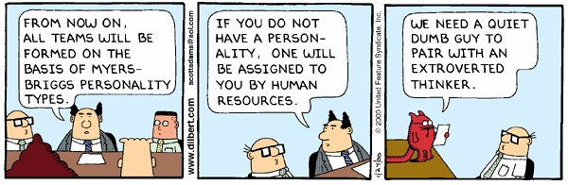
MBTI
20% ~ 40% of developers are ISTJ

Slide 8
ISTJ
What is the downside of being an ISTJ?

Slide 9
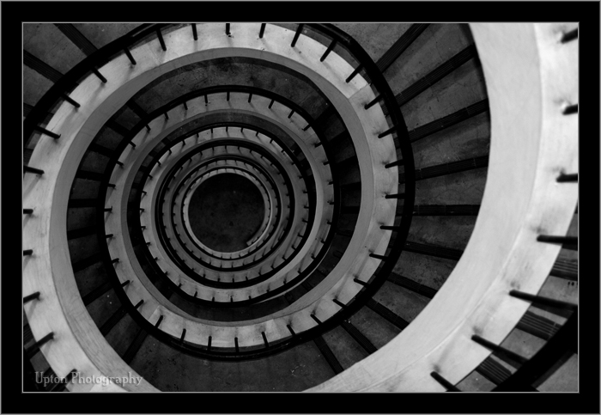
Downward spiral

Slide 10

Perspective

Slide 11
Upward spiral
This is interesting!
This is fun!
Let me try it.
It works!
It doesn't work… (Go to 3)
Go to 1.

Slide 12
Conclusion
Try various things to figure out what you really like
Look at things from a different perspective
Constantly seek out fun and challenging things to do

Slide 13
Exercise
Let’s use imgrr on ggc-talk.
Study how it works.
Post your project idea on Piazza.
Work on your project with your group members.

